Slide 1

Authentication and Security
SoftUni Team
Technical Trainers
Software University
https://softuni.org

Slide 2
Table of Contents
The Identity in the Web
Authentication
Authentication in Django
Permissions and Authorization
Security
2
Notes:
2

Slide 3
Have a Question?
sli.do
#python-web
Notes:
3

Slide 4

The Identity in the Web

Slide 5
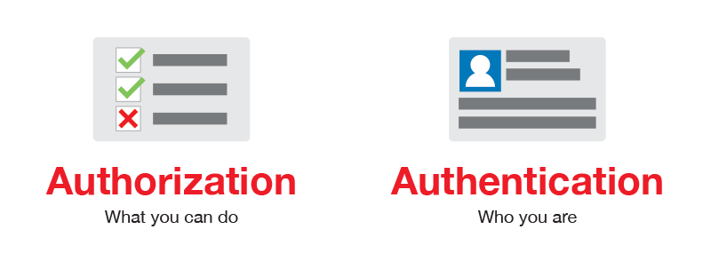
Authorization vs. Authentication (1)

Slide 6
Authorization vs. Authentication (2)
Authorization
The process of determining what a user is permitted to do on a computer or network
Questions: What are you allowed to do? Can you see this page?
Authentication
The process of verifying the identity of a user or computer
Questions: Who are you? How you prove it?
Credentials can be password, smart card, external token, etc.

Slide 7
Identification vs. Authentication (2)
Identification
The ability to identify uniquely a user of a system or an application that is running in the system
The system uses the username to identify the user
Authentication
The ability to prove that a user or application is genuinely who that person or what that application claims to be
The system checks if the password is correct to authenticates the user

Slide 8

Authentication

Slide 9
How Authentication Works
During authentication, credentials provided by the user are compared to those in a database of authorized users' information
If the credentials match, the process is completed, and the user is granted access
A user ID and a password is the most basic type of authentication
There are more authentication factors

Slide 10
Authentication Factors
Represent some piece of data or attribute that can be used to authenticate a user requesting access to a system
Single-factor authentication
e.g., a user ID and a password authentication
Two-factor authentication
The knowledge factor on one side
The biometric/ possession factor on the other, e.g., security token

Slide 11
Authentication in Django
Django

Slide 12
Authentication in Django
Django comes with a user authentication system
It handles both authentication and authorization
It consists of:
Users, groups and permissions
A configurable password hashing system
Forms and view tools for logging in users, or restricting content
A pluggable backend system
It handles cookie-based user sessions

Slide 13
Authentication in Django
The configuration is already included in the settings.py listed in INSTALLED_APPS setting:
'django.contrib.auth'
Contains the core of the authentication framework, and its default models
'django.contrib.contenttypes'
Allows permissions to be associated with models

Slide 14
django.contrib.auth
Serve the most common project needs
We can inherit from its URLs, models, views and forms
Handles a reasonably wide range of tasks
Has a careful implementation of passwords and permissions
Supports extension and customization of authentication

Slide 15
Cookie-Based Authentication
Django provides full support for anonymous sessions
It lets you store and retrieve arbitrary data on a per-site-visitor basis
It stores data on the server side and abstracts the sending and receiving of cookies
Cookies contain a session ID – not the data itself
SessionMiddleware manages sessions across requests
AuthenticationMiddleware associates users with requests using sessions

Slide 16

The User in Django
Notes:
16

Slide 17
The User
A user is an individual accessing a website through a web browser
They can interact with the site and can enable things like restricting access, registering user profiles, associating content with creators etc.
In Django the user objects are the core of the authentication system

Slide 18
The User Model
Only one class of user exists in Django's authentication framework
'superusers' or admin 'staff' users are just user objects with special attributes set
It inherits from AbstractUser, which inherits form AbstractBaseUser and PermissionsMixin
from django.contrib.auth.models import User

Slide 19
The User Fields (1)
The primary fields of the default user are:
username - required, 150 characters or fewer
password - required, Django doesn't store the raw password
email - optional
first_name - optional, 150 characters or fewer
last_name - optional, 150 characters or fewer

Slide 20
The User Fields (2)
Other fields of the default user are:
groups - many-to-many relationship to Group
user_permissions - many-to-many relationship to Permission
is_staff - Boolean
is_active - Boolean
is_superuser - Boolean
last_login - datetime of the user's last login
date_joined - set to the current date/time by default

Slide 21
The User Attributes
Two attributes:
is_authenticated
Read-only attribute which is always True
is_anonymous
Read-only attribute which is always False
Note: prefer using is_authenticated

Slide 22
The User Methods Examples
get_username() - returns the username for the user (use this method instead of referencing the username attribute directly)
get_full_name() - returns "{first_name} {last_name}"
get_short_name() - returns first_name only
All user methods: https://docs.djangoproject.com/en/4.0/ref/contrib/auth/#methods

Slide 23
The AnonymousUser Class
Implements the User interface, with some differences, e.g.:
id is always None
username is always the empty string
is_staff and is_superuser are always False
is_authenticated always return False
The AnonymousUser objects are used by web requests

Slide 24
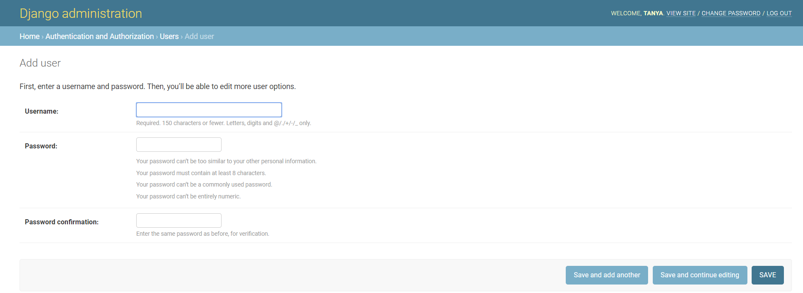
Create User
To create a new User, we can use the built-in helper function create_user()
Or using the Django Admin
from django.contrib.auth.models import User
user = User.objects.create_user('peter', 'peter@gmail.com', 'peterpass')

Slide 25
Authenticate Users
We can use the authenticate() function to verify credentials (for login)
If the credentials are not valid, None is returned
Note: It is a low-level way to authenticate a set of credentials
from django.contrib.auth import authenticate
user = authenticate(username='peter', password='peterpass')
if user:
# Credentials are valid
else:
# Credentials are not valid

Slide 26
Authentication in Web Requests
The request.user attribute on every request represents the current user
If the current user is logged in, it is set to an instance of User
Otherwise, it is set to an instance of AnonymousUser
if request.user.is_authenticated:
# Do something for authenticated users
...
else:
# Do something for anonymous users
...

Slide 27
Login
To log a user in, from a view, use login()
It takes an HttpRequest object and a User object
from django.contrib.auth import login
def index(request):
some_user = User.objects.get(username='Peter')
print(request.user.__class__.__name__) # AnonymousUser
login(request, some_user)
print(request.user.__class__.__name__) # User
return render(request, 'home_page.html')

Slide 28
Logout
To log out a user who has been logged in via login(), use logout() within the view
It takes an HttpRequest object and does not return anything
from django.contrib.auth import logout
def logout_page(request):
print(request.user.__class__.__name__) # User
logout(request, some_user)
print(request.user.__class__.__name__) # AnonymousUser
return render(request, 'logout_page.html')

Slide 29

Permissions and Authorization

Slide 30
What is Authorization?
Authorization includes the process through which an administrator grants rights to authenticated users
The privileges and preferences granted for the authorized account depend on the user's permissions
The settings defined for all these environment variables are set by an administrator

Slide 31
Authorization and Permissions in Django
Django comes with a built-in permissions system
It provides a way to assign permissions to specific users or groups of users
It's used by the Django admin site, but you can use it in your own code
It is possible to customize permissions for different object instances of the same type

Slide 32
Default Permissions
Four default permissions
add, change, delete, view
They are created for each Django model defined in the installed applications
user = User.objects.get(username='admin')
user.has_perm('main_app.add_employee') # True
user.has_perm('main_app.change_employee') # True
user.has_perm('main_app.delete_employee') # True
user.has_perm('main_app.view_employee') # True

Slide 33
Django Permissions in Groups
Instead of managing the permissions of each User, we can use Groups
For example, we can create a group User, and each new User will belong to that group
Then, we can add permissions to that Group, so it applies to each member of the Group

Slide 34
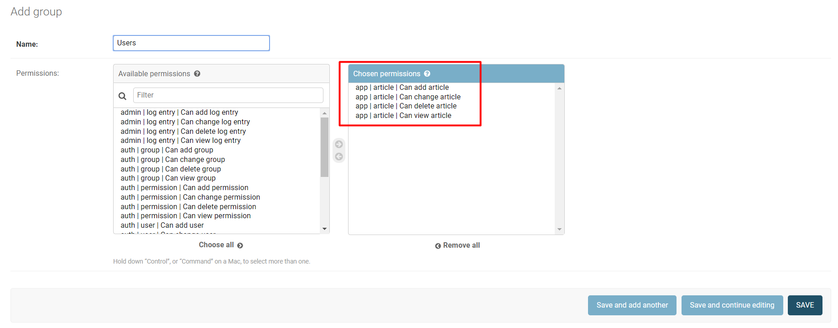
Example: Permissions in Groups

Slide 35
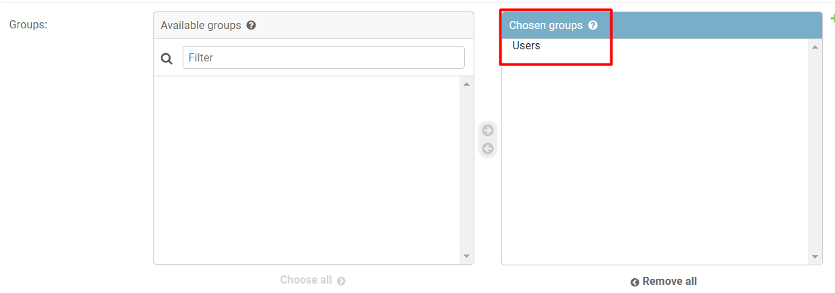
Example: User in Users Group
The user now belongs to the group

Slide 36
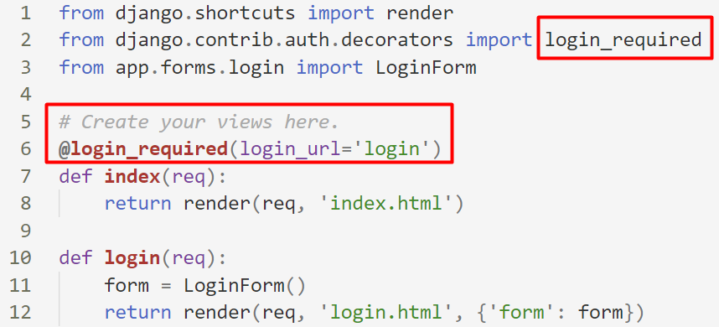
Using Built-In Decorators
There are some built-in decorators in Django, which allow us to add permission control
The decorator checks whether there is a logged in user

Slide 37
Creating Custom Decorators
We can make our custom decorators that will validate if a user has a given permission
To do that, we create a decorators.py file in our app
For example, if we want to show articles only if the user has permission (belongs to the Users group), we can create a decorator function that makes the validation
More about permissions: https://docs.djangoproject.com/en/4.0/topics/auth/default/#limiting-access-to-logged-in-users

Slide 38
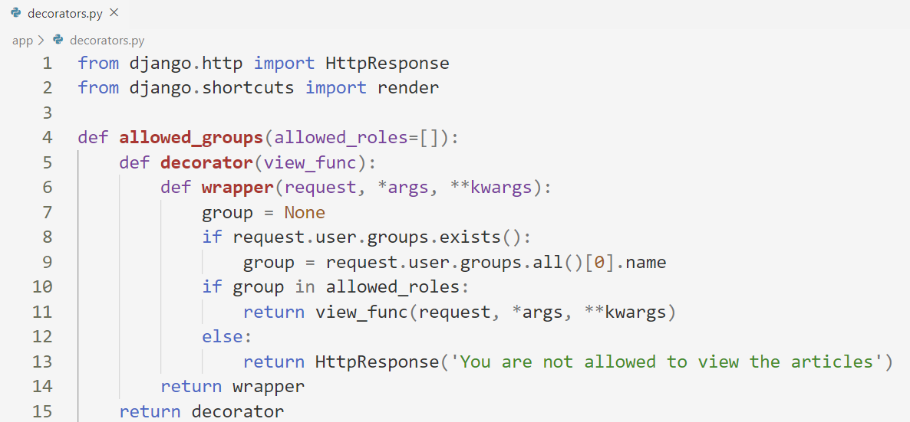
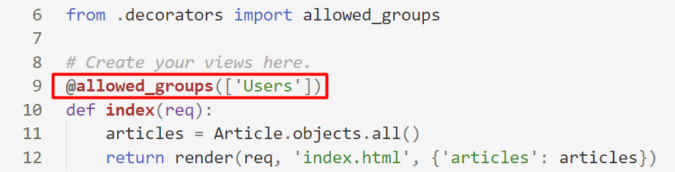
Example: Creating Custom Decorators

Slide 39

Web Security

Slide 40








Most Common Web Security Problems
SQL Injection
Cross-site Scripting (XSS)
URL/HTTP manipulation attacks (Parameter Tampering)
Cross-site Request Forgery (CSRF)
Brute Force Attacks (also DDoS)
Insufficient Access Control
Missing SSL (HTTPS) / MITM
Phishing/Social Engineering
Dev

Slide 41
Cross Site Scripting (XSS)
Allows the user to inject client-side scripts into the browsers of other users
By storing the malicious scripts in the database where it will be retrieved and displayed to other users
By getting users to click a link which will cause the attacker's JavaScript to be executed by the user's browser
It can originate from any untrusted source of data whenever the data is not sufficiently sanitized before including in a page

Slide 42
XSS in Django
Django templates protects you against the majority of XSS attacks
Django templates escape specific characters which are particularly dangerous to HTML, but it is not entirely foolproof
If var is set to 'class1 onmouseover=javascript:func()', this can result in unauthorized JavaScript execution
Quoting the attribute value would fix this case
<style class={{ var }}>...</style>
More about XSS in Django: https://docs.djangoproject.com/en/4.0/ref/templates/language/#automatic-html-escaping

Slide 43
bleach
Bleach is an allowed-list-based HTML sanitizing library that escapes or strips markup and attributes
Intended for sanitizing text from untrusted sources
Security-focused library
Install it using the terminal command
pip install bleach

Slide 44
SQL Injection (1)
The following SQL commands are executed:
Usual search (no SQL injection):
SQL-injected search (matches all records):
SQL-injected INSERT command:
SELECT * FROM Messages WHERE MessageText LIKE '%Nikolay.IT%';
SELECT * FROM Messages WHERE MessageText LIKE '%%%%';
SELECT * FROM Messages WHERE MessageText LIKE '%' or 1=1 --%';
SELECT * FROM Messages WHERE MessageText
LIKE '%'; INSERT INTO Messages(MessageText, MessageDate) VALUES ('Hacked!!!', '1.1.1980') --%'"

Slide 45
SQL Injection (2)
Original SQL Query:
Setting username to John & password to ' OR '1'= '1 produces
The result
The user with username – "Admin" will login WITHOUT password
The passed query will turn into a Boolean expression which is always True
sql_query = "SELECT * FROM user WHERE name = '" + username + "' AND pass='" + password + "'";
sql_query = SELECT * FROM user WHERE name = 'Admin' AND pass='' OR '1'='1''

Slide 46
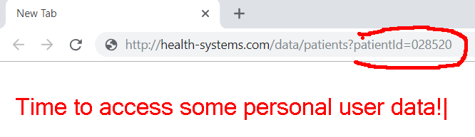
Parameter Tampering
Parameter Tampering is the manipulation of parameters exchanged between client and server
Altered query strings, request bodies, cookies
Skipped data validations, Injected additional parameters

Slide 47

Cross-Site Request Forgery (1)
Cross-Site Request Forgery (CSRF / XSRF) is a web security attack over the HTTP protocol
Allows executing unauthorized commands on behalf of some user
By using his cookies stored in the browser
The user has valid permissions to execute the requested command
The attacker uses these permissions maliciously, unbeknownst to the user

Slide 48

Cross-Site Request Forgery (2)
What Cross-Site Request Forgery actually is:
The user can even misclick the button accidentally
This will still trigger the attack
Security against such attacks is necessary
It protects both your app and your clients
<!-- SOME MULTI-COLOR USELESS CLICKBAIT CONTENT --> <form action="http://good-banking-site.com/api/account" method="post">
<input type="hidden" name="Transaction" value="withdraw">
<input type="hidden" name="Amount" value="1000000">
<input type="submit" value="Click to collect your prize!">
</form>

Slide 49

Demo
Live Exercise in Class

Slide 50

Summary
Authentication is the act of proving an assertion, such as the identity of a computer system user
Authorization includes the process through which an administrator grants rights to authenticated users
Notes:
50

Slide 51
Questions?
Notes:
51

Slide 52













SoftUni Diamond Partners

Slide 53


Educational Partners

Slide 54

License
This course (slides, examples, demos, exercises, homework, documents, videos and other assets) is copyrighted content
Unauthorized copy, reproduction or use is illegal
© SoftUni – https://softuni.org
© Software University – https://softuni.bg
Notes:
54

Slide 55
Trainings @ Software University (SoftUni)
Software University – High-Quality Education, Profession and Job for Software Developers
softuni.bg, softuni.org
Software University Foundation
softuni.foundation
Software University @ Facebook
facebook.com/SoftwareUniversity
Software University Forums
forum.softuni.bg
Notes:
55

